Slide 1
2021 CO-OP OPPORTUNITIES
Television, Outdoor Digital,
Online Partner Sites and Social Media

Slide 2
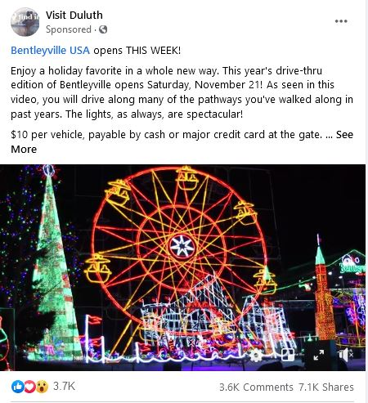
Facebook Ads
60/40 Split $500 Maximum Annual Total Buy
Five individual $100 campaigns of 3-7 days is recommended
Duration: Max of 1week
Available: All Year *Production not included
$200 Maximum Visit Duluth Contribution (40% of $500 total buy)

Slide 3
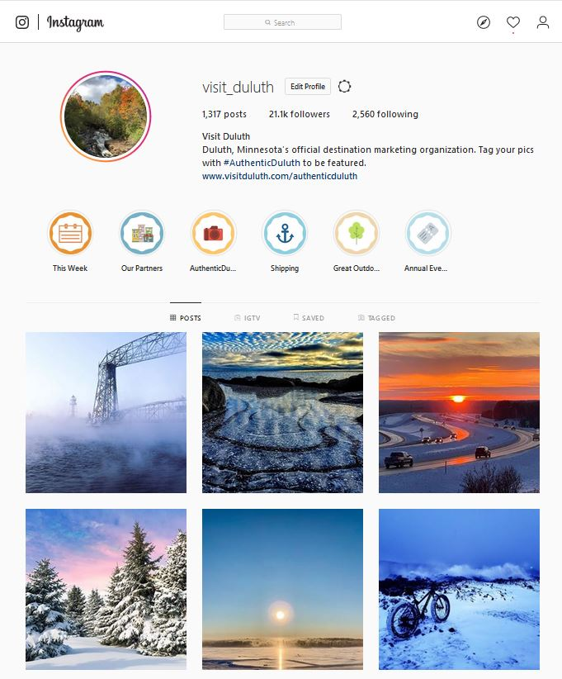
Instagram Feature Story
24 Hour Partner Exclusive Promotion
Cost $300
Feature Story posts for your organization or business highlighted on the Visit Duluth Instagram page with up to 10 Instagram story slides, and 1 post on Visit Duluth’s main page
No other content posted that day
Story cross-promotion on other social media sites
Duration: One Day
Available: All Year Limited to one per calendar year
Two weeks advance notice required for space requests
*Production included
Partner to provide story content and slides Visit Duluth may edit content if necessary
Approval of the requested date is based on space
availability on the content calendar

Slide 4
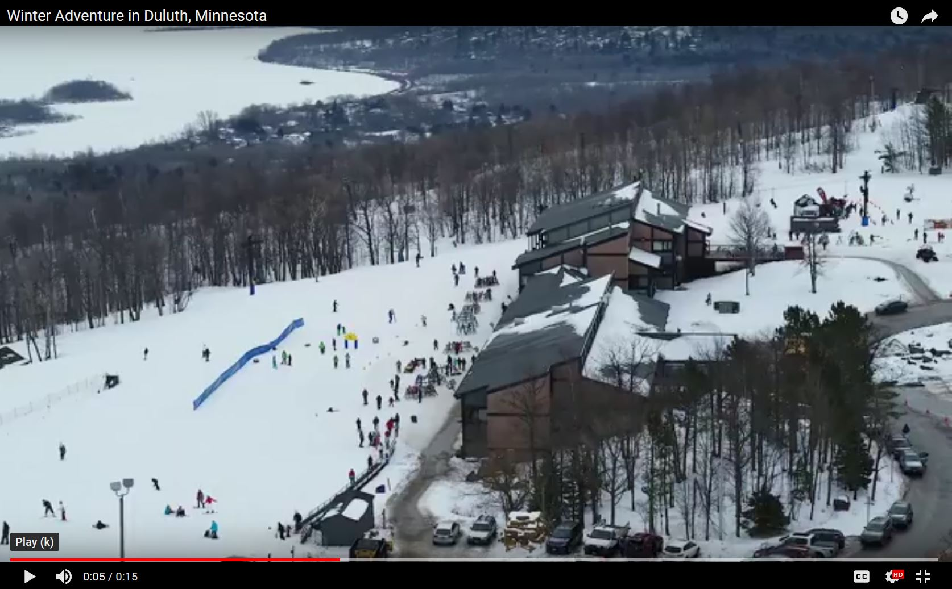
15 Second TV Spots
Digital Billboards
Cost: $800
Number of Spots: Part of the Visit Duluth rotation of ads on 6 highly visible location in the Twin Cities.
Four Week buy
*Production not included
Cost: $5,000
Number of Spots: Partners spots are mixed into the overall Visit Duluth campaign buy
Duration: 4-6 weeks Runs during Visit Duluth Seasonal buys on Twin Cities Stations
Other Cities and State varies with season and may be available
Available: Spring/Summer and Winter
*Production not included

Slide 5
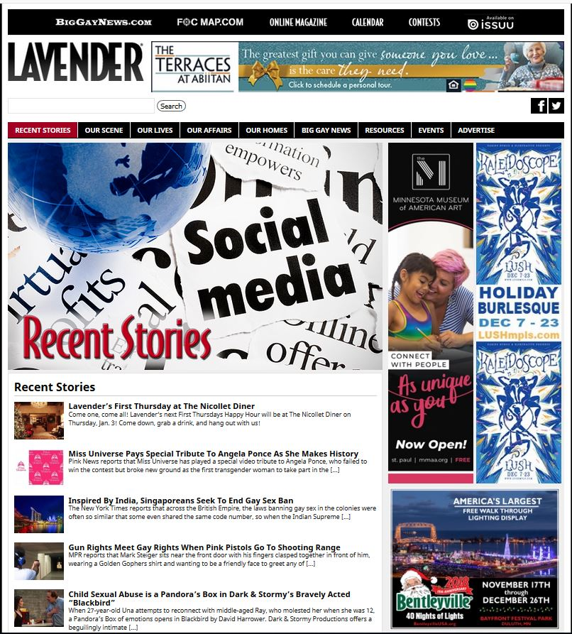
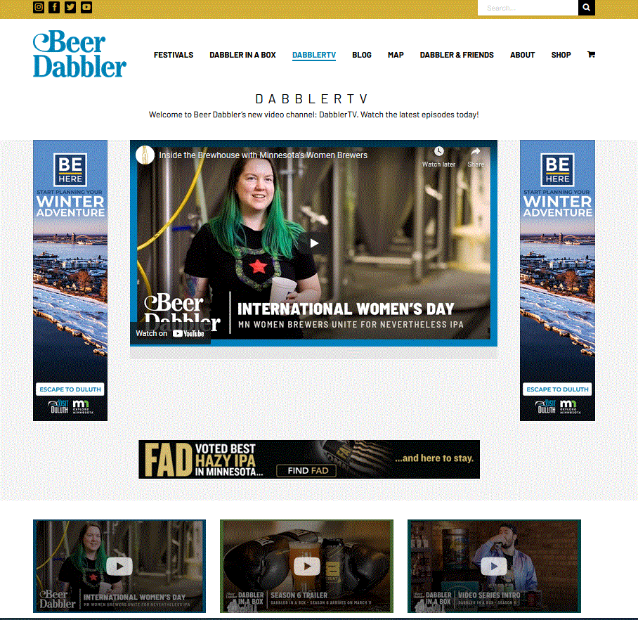
Lavendermagazine.com
Beerdabbler.com
Size: 300 x 250
Cost: $100/mo.
8 Available (Jan. – Dec.)
Size: 300 x 600
Cost: $50/mo.
8 Available (Jan. – Dec.)

Slide 6
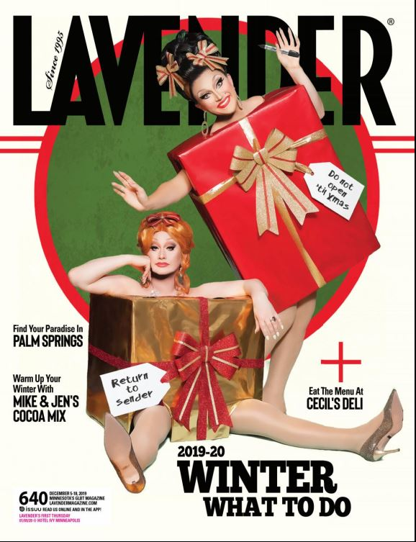
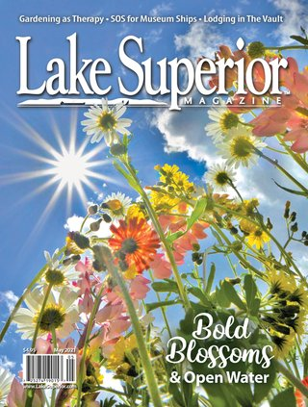
Magazine Print Ads
-
Cost: Varies by publication - Range $300 - $600
Available: Specific months - Inquire about openings and publications you are interested in advertising in.
*Production not included

